Slide 1
Lecture 1: Likelihoods and linear models
March 29, 2016

Slide 2
[Go through syllabus]

Slide 3
How do we estimate things?
Specify a model
Function generating predictions
Identify plausible values for any unknown parameters
Maximize probability of observations given function
Assess uncertainty
Explore function around plausible values

Slide 4
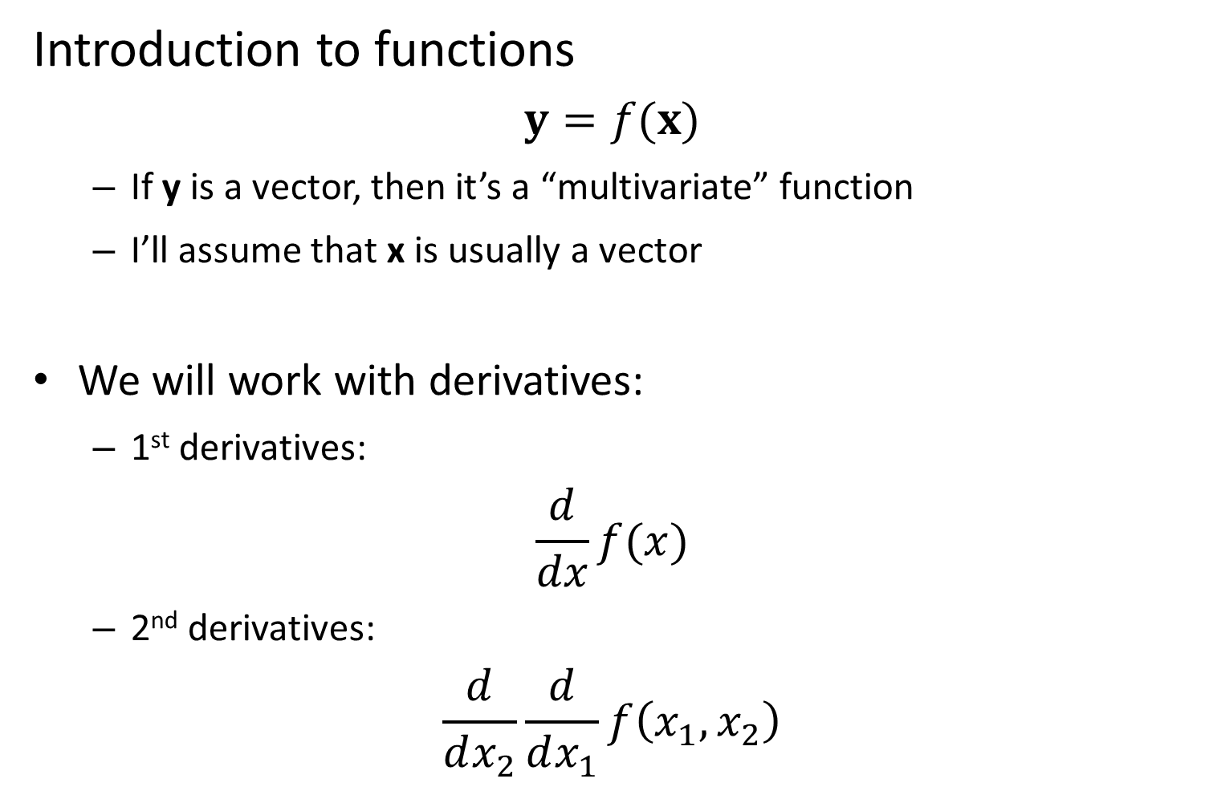
Introduction to functions
$$y=f(x)$$
If y is a vector, then it’s a “multivariate” function
I’ll assume that x is usually a vector
We will work with derivatives:
1st derivatives:
$$\frac{d}{dx}f(x)$$
2nd derivatives:
$$\frac{d}{dx_{2}}\frac{d}{dx_{1}}f\left(x_{1},x_{2}\right)$$

Slide 5
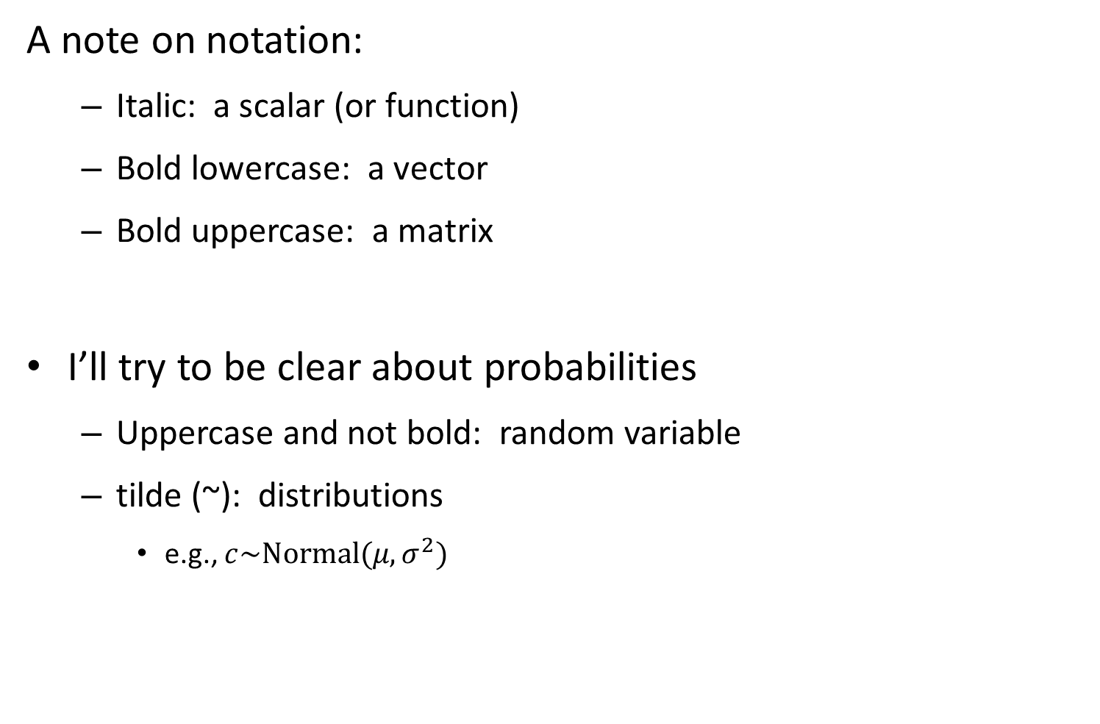
A note on notation:
Italic: a scalar (or function)
Bold lowercase: a vector
Bold uppercase: a matrix
I’ll try to be clear about probabilities
Uppercase and not bold: random variable
tilde (~): distributions
e.g., $c\sim Normal(μ,σ^{2})$

Slide 6
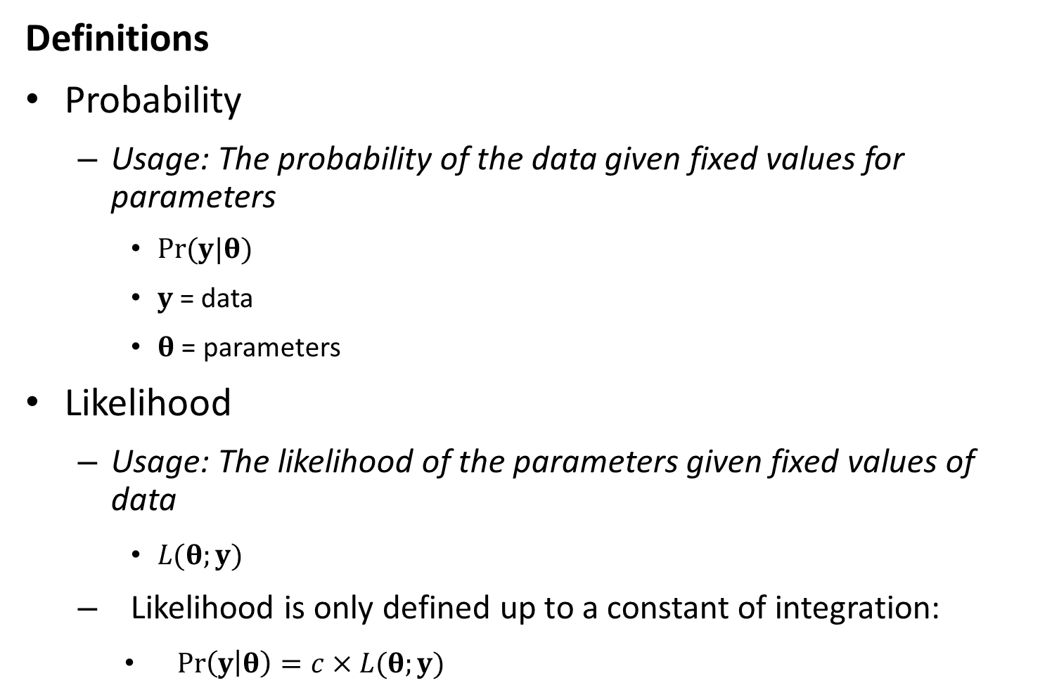
Definitions
Probability
Usage: The probability of the data given fixed values for parameters
$Pr⁡(y|θ)$
$y$= data
$θ$ = parameters
Likelihood
Usage: The likelihood of the parameters given fixed values of data
$L(θ;y)$
Likelihood is only defined up to a constant of integration:
$\operatorname{Pr}\left(y | θ\right)=c×L(θ;y)$

Slide 7
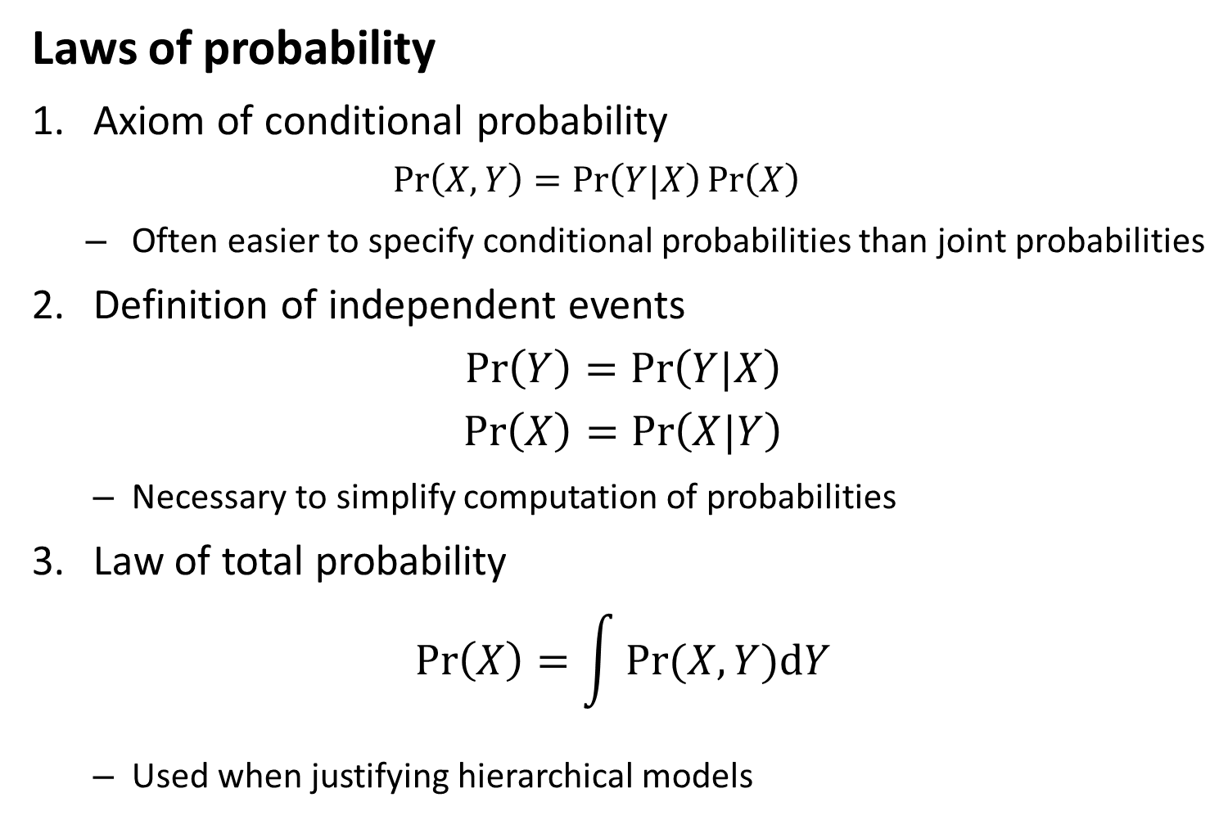
Laws of probability
1. Axiom of conditional probability
$$\operatorname{Pr}\left(X,Y\right)=\operatorname{Pr}\left(Y|X\right)\operatorname{Pr}\left(X\right)$$
Often easier to specify conditional probabilities than joint probabilities
2. Definition of independent events
$$\operatorname{Pr}\left(Y\right)=\operatorname{Pr}\left(Y|X\right)$$
$$\operatorname{Pr}\left(X\right)=\operatorname{Pr}\left(X|Y\right)$$
Necessary to simplify computation of probabilities
3. Law of total probability
$$\operatorname{Pr}\left(X\right)=\int{Pr⁡(X,Y)dY}$$
Used when justifying hierarchical models

Slide 8
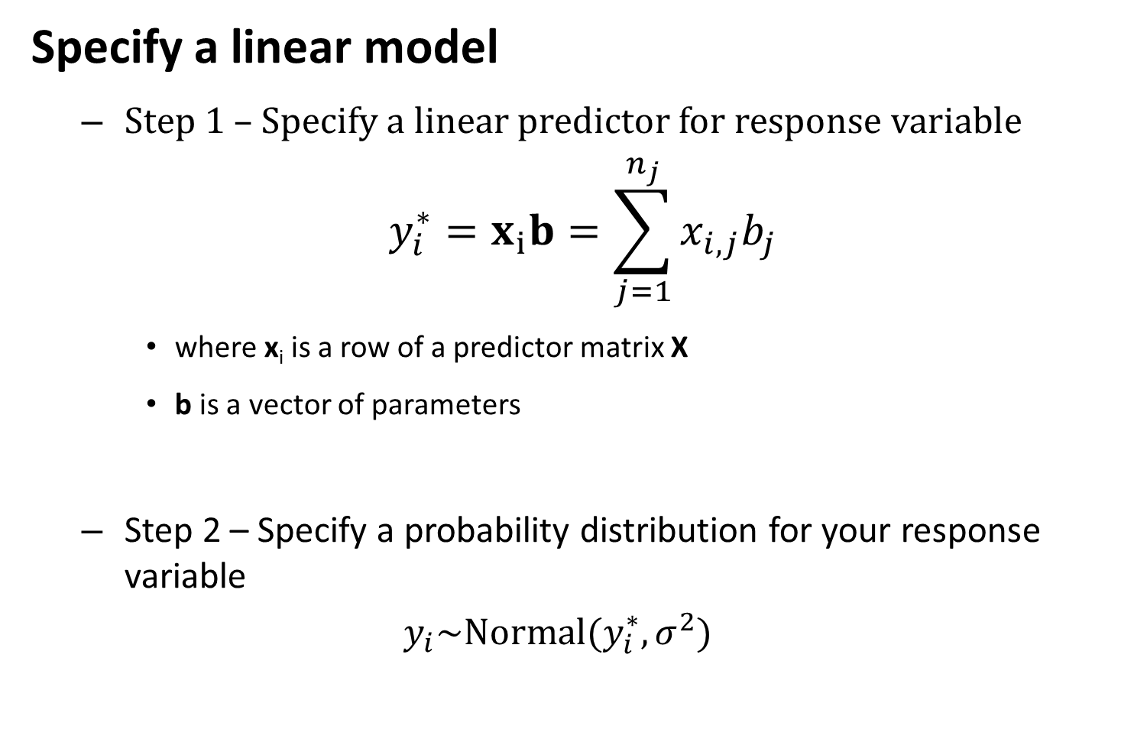
Specify a linear model
Step 1 – Specify a linear predictor for response variable
$$y_{i}^{∗}=x_{i}b=\sum_{j=1}^{n_{j}}{x_{i,j}b_{j}}$$
where x_{i} is a row of a predictor matrix X
b is a vector of parameters
Step 2 – Specify a probability distribution for your response variable
$$y_{i}\sim Normal(y_{i}^{∗},σ^{2})$$

Slide 9

Maximum likelihood estimation (MLE)
$$\hat{θ}=argmax_{θ}\left(L(θ;y)\right)$$
Where $\hat{θ}$ is the MLE estimate of parameters
Where$argmax_{θ}\left(L(θ;y)\right)$is the maximum value for $L(θ;y)$that can be achieved for any value of $θ$
argmax is done using maximization algorithms

Slide 10
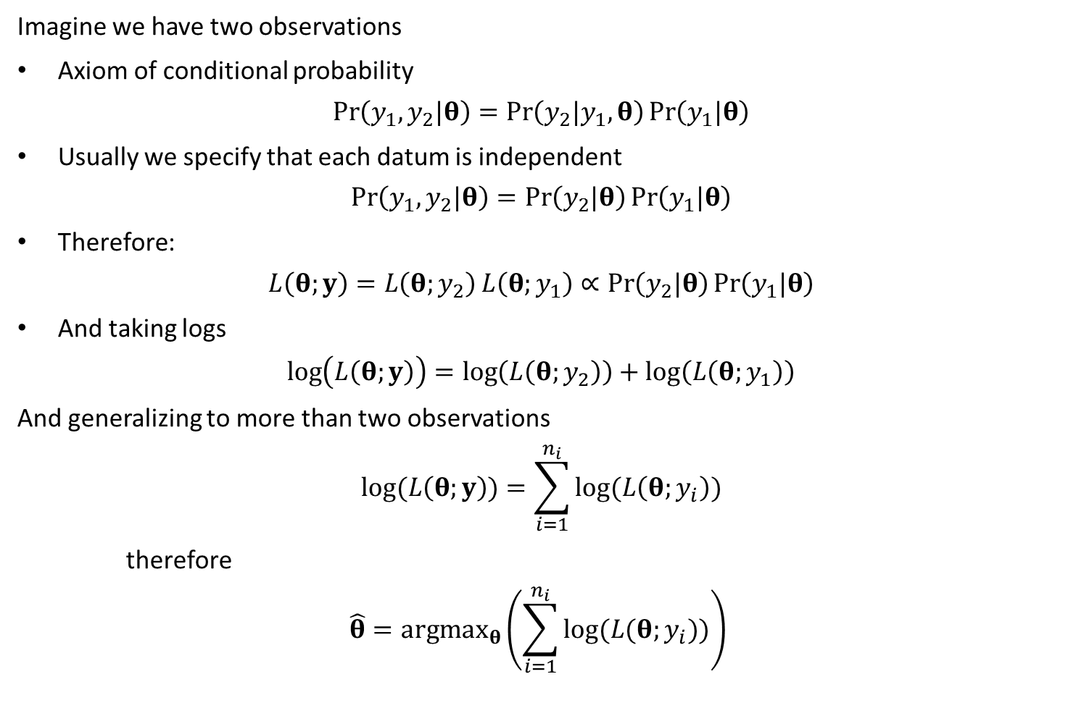
Imagine we have two observations
Axiom of conditional probability
$$\operatorname{Pr}\left(y_{1},y_{2}|θ\right)=\operatorname{Pr}\left(y_{2}|y_{1},θ\right)\operatorname{Pr}\left(y_{1}|θ\right)$$
Usually we specify that each datum is independent
$$\operatorname{Pr}\left(y_{1},y_{2}|θ\right)=\operatorname{Pr}\left(y_{2}|θ\right)\operatorname{Pr}\left(y_{1}|θ\right)$$
Therefore:
$$L\left(θ;y\right)=L\left(θ;y_{2}\right)L\left(θ;y_{1}\right)∝\operatorname{Pr}\left(y_{2}|θ\right)\operatorname{Pr}\left(y_{1}|θ\right)$$
And taking logs
$$\log\left(L\left(θ;y\right)\right)=\log\left(L\left(θ;y_{2}\right)\right)+\log\left(L\left(θ;y_{1}\right)\right)$$
And generalizing to more than two observations
$$log⁡(L\left(θ;y\right))=\sum_{i=1}^{n_{i}}{log⁡(L\left(θ;y_{i}\right))}$$
therefore
$$\hat{θ}=argmax_{θ}\left(\sum_{i=1}^{n_{i}}{log⁡(L(θ;y_{i}))}\right)$$

Slide 11
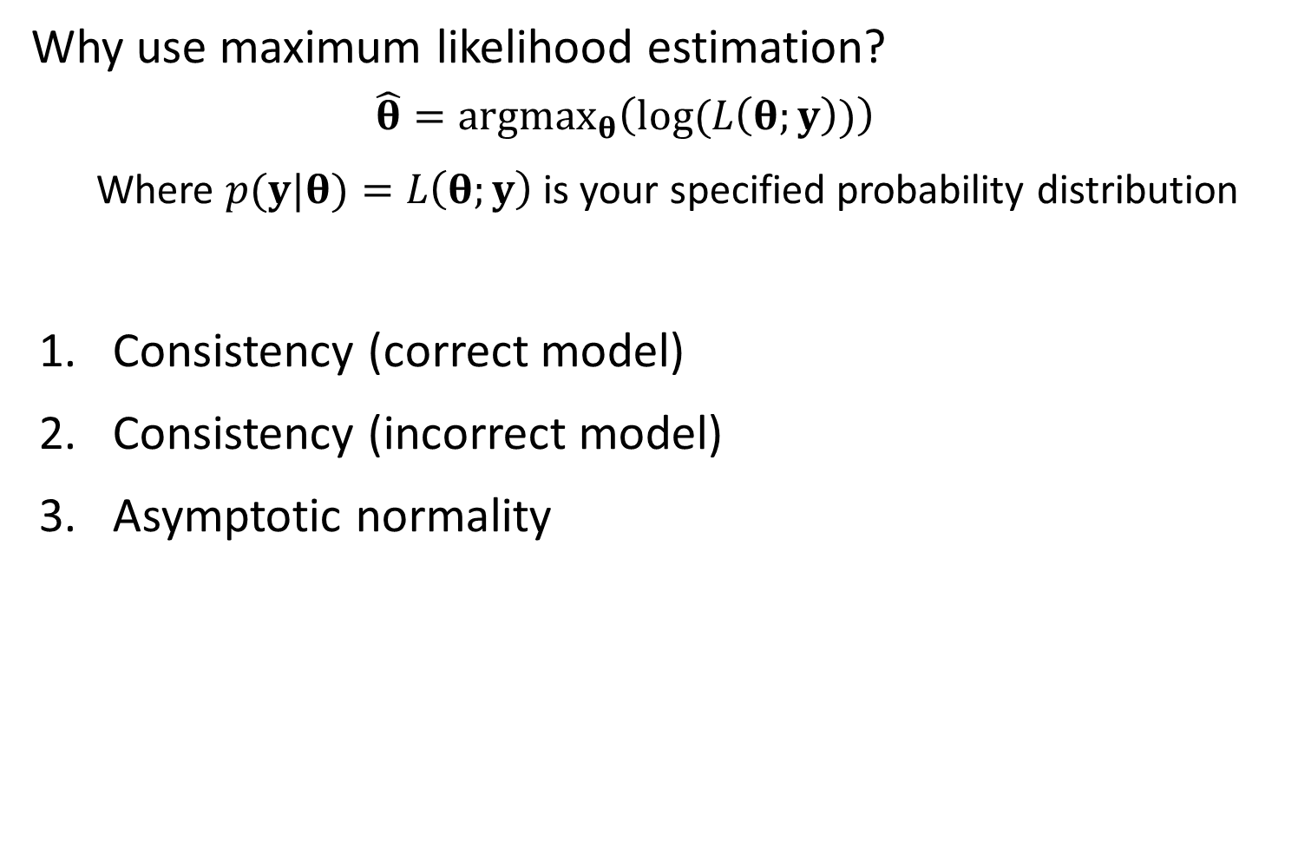
Why use maximum likelihood estimation?
$$\hat{θ}=argmax_{θ}\left(log⁡(L\left(θ;y\right))\right)$$
Where $p(y|θ)=L\left(θ;y\right)$ is your specified probability distribution
Consistency (correct model)
Consistency (incorrect model)
Asymptotic normality

Slide 12
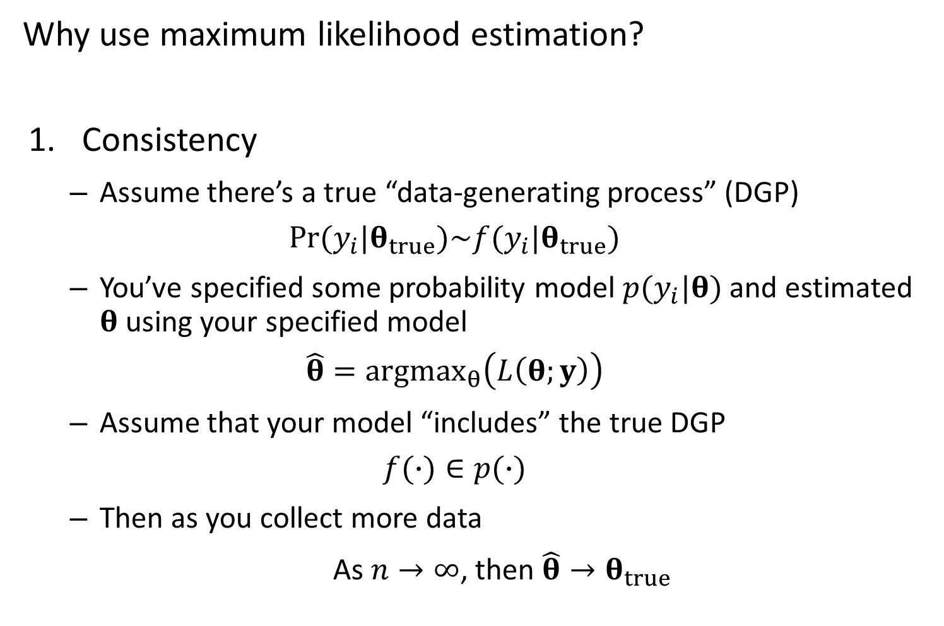
Why use maximum likelihood estimation?
Consistency
Assume there’s a true “data-generating process” (DGP)
$$Pr⁡(y_{i}|θ_{true})\sim f(y_{i}|θ_{true})$$
You’ve specified some probability model $p(y_{i}|θ)$ and estimated $θ$ using your specified model
$$\hat{θ}={argmax}_{θ}\left(L\left(θ;y\right)\right)$$
Assume that your model “includes” the true DGP
$$f(∙)∈p(∙)$$
Then as you collect more data
As $n→∞$, then $\hat{θ}→θ_{true}$

Slide 13
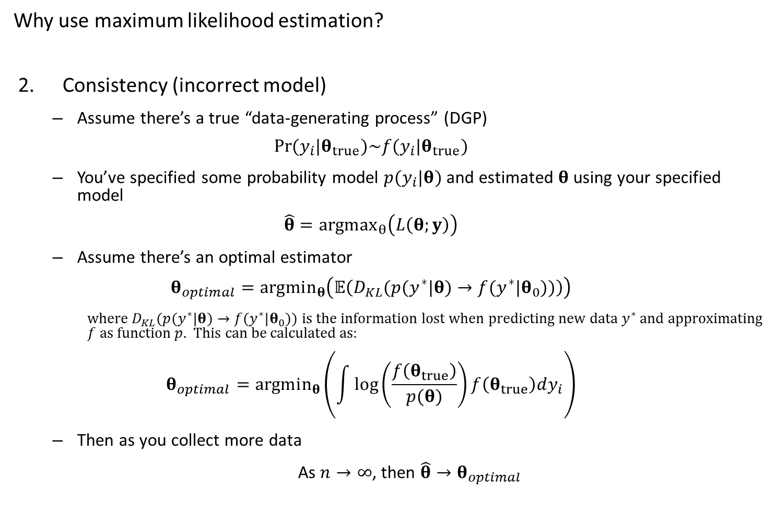
Why use maximum likelihood estimation?
Consistency (incorrect model)
Assume there’s a true “data-generating process” (DGP)
$$Pr⁡(y_{i}|θ_{true})\sim f(y_{i}|θ_{true})$$
You’ve specified some probability model $p(y_{i}|θ)$ and estimated $θ$ using your specified model
$$\hat{θ}={argmax}_{θ}\left(L\left(θ;y\right)\right)$$
Assume there’s an optimal estimator
$$θ_{optimal}=argmin_{θ}\left(𝔼\left(D_{KL}(p(y^{∗}|θ)→f(y^{∗}|θ_{0}))\right)\right)$$
where $D_{KL}(p(y^{∗}|θ)→f(y^{∗}|θ_{0}))$ is the information lost when predicting new data $y^{∗}$ and approximating $f$ as function $p$. This can be calculated as:
$$θ_{optimal}=argmin_{θ}\left(\int{\log\left(\frac{f\left(θ_{true}\right)}{p(θ)}\right)f\left(θ_{true}\right)dy_{i}}\right)$$
Then as you collect more data
As $n→∞$, then $\hat{θ}→θ_{optimal}$

Slide 14
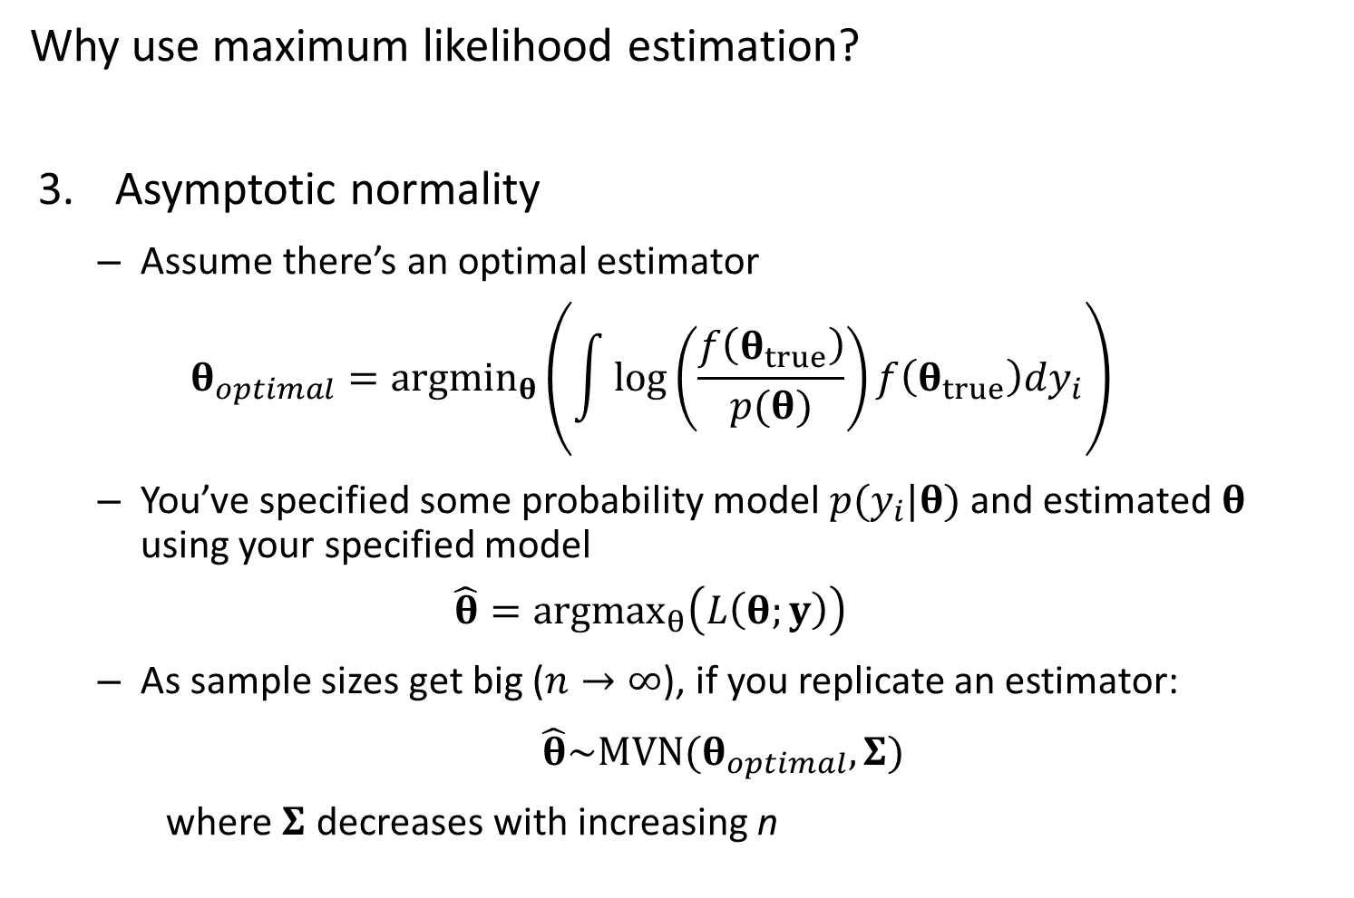
Why use maximum likelihood estimation?
Asymptotic normality
Assume there’s an optimal estimator
$$θ_{optimal}=argmin_{θ}\left(\int{\log\left(\frac{f\left(θ_{true}\right)}{p(θ)}\right)f\left(θ_{true}\right)dy_{i}}\right)$$
You’ve specified some probability model $p(y_{i}|θ)$ and estimated $θ$ using your specified model
$$\hat{θ}={argmax}_{θ}\left(L\left(θ;y\right)\right)$$
As sample sizes get big ($n→∞$), if you replicate an estimator:
$\hat{θ}\sim MVN(θ_{optimal},Σ)$
where $Σ$ decreases with increasing n

Slide 15
Implications
If you have a simulation design…
… and the model used to simulate data is identical to the model used to estimate parameters
Estimated parameters will be perfect with large sample sizes
Total error will go to zero with large sample sizes
… and your estimation model doesn’t match the simulation model
Estimated parameters will converge on values with large sample sizes
Total error will decrease to an asymptote

Slide 16
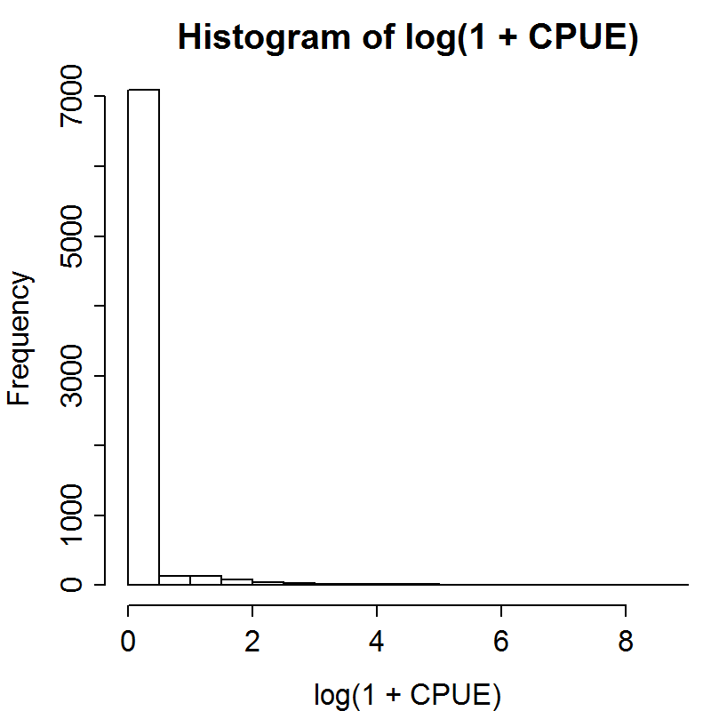
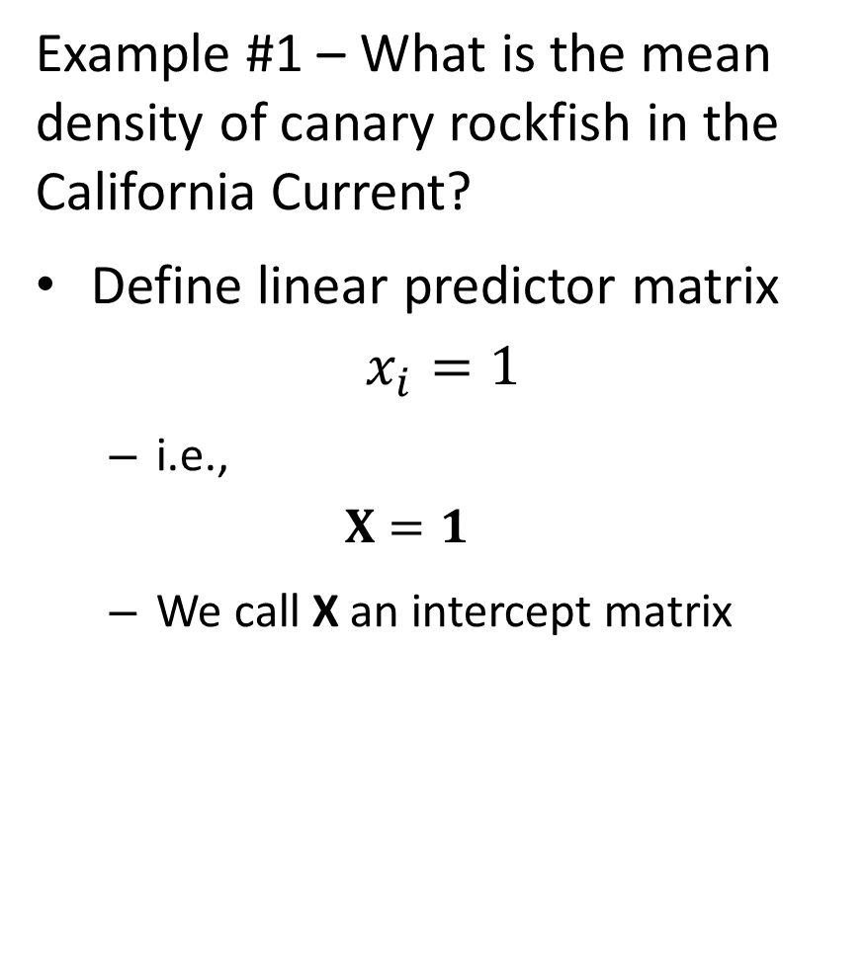
Example #1 – What is the mean density of canary rockfish in the California Current?
Define linear predictor matrix
$$x_{i}=1$$
i.e.,
$$X=1$$
We call X an intercept matrix

Slide 17
Approach 1 – Use existing R functions
Step 1 – Find function
For linear model, use lm in the base package
Step 2 – Apply function
Usually easy in R
Step 3 – Extract information from object
Often hard
Sometimes use summary or attributes commands

Slide 18
Approach 1
[See R code]

Slide 19
Approach 2 – Build your own code
Step 1 – make function for log-likelihood
Step 2 – use nonlinear minimizer to find maximum likelihood estimate
Step 3 – estimate standard errors

Slide 20
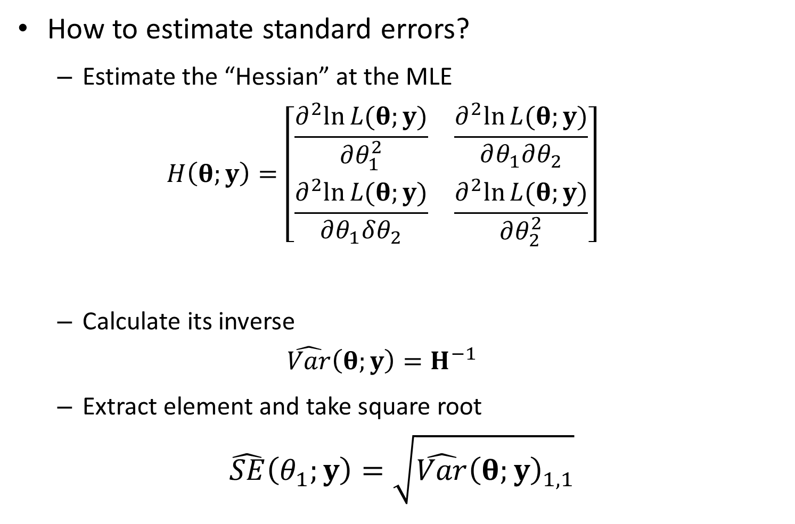
How to estimate standard errors?
Estimate the “Hessian” at the MLE
$$H\left(θ;y\right)=\left[\begin{matrix}\frac{∂^{2}ln⁡L(θ;y)}{∂θ_{1}^{2}} & \frac{∂^{2}ln⁡L(θ;y)}{∂θ_{1}∂θ_{2}} \\ \frac{∂^{2}ln⁡L(θ;y)}{∂θ_{1}δθ_{2}} & \frac{∂^{2}ln⁡L(θ;y)}{∂θ_{2}^{2}}\end{matrix}\right]$$
Calculate its inverse
$$\hat{Var}\left(θ;y\right)=H^{−1}$$
Extract element and take square root
$$\hat{SE}\left(θ_{1};y\right)=\sqrt{\hat{Var}{\left(θ;y\right)}_{1,1}}$$

Slide 21
Approach 2
[See R code]

Slide 22
Approach 3 – Use TMB
Step 1 – Define TMB template file
Uses C++ code
Step 2 – Define inputs for TMB
List of “tagged” (named) elements for data and starting paramesters
Step 3 – Run optimizer in R
Nonlinear optimizers using gradients
Step 4 – Check model diagnostics

Slide 23
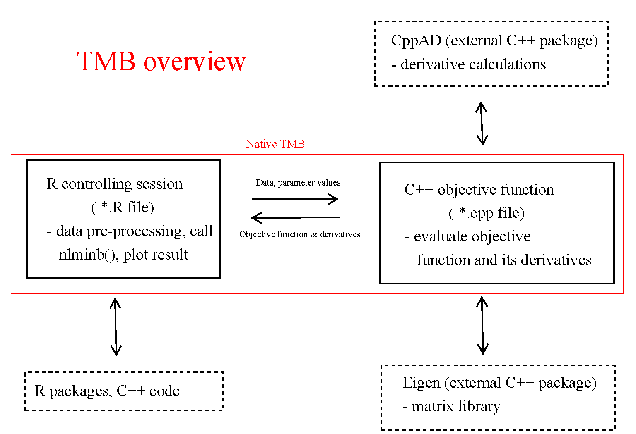

Slide 24
Approach 3
[See R code]

Slide 25
How to know you understand a model?
Make predictions about behavior, and double check predictions
Simulation experiments
Next step:
Add covariates (pass and latitude)
Prediction: Adding fixed effects will always decrease the residual variance in a linear model

Slide 26
Testing prediction: effect of adding linear predictors
[See R code]
Was the prediction supported?

